Slide 1


#Hashtags as a Means for Political Action
Exploring the Impact of Hashtag Activism on Political Processes Using Geolocated Social Media Posts Data
Leonardo Nicoletti

Slide 2
Overview
Research problem and research objectives
Theoretical framework
Methods and experimental design
Some results
Thesis completion status + next steps

Slide 3
Problem Introduction
#Hashtag Activism today → crucial strategy for activists to influence social change
Lots of research in this field
Importance for shaping the structure of social movements
Importance for shaping political discourse and narratives
Last summer: #JusticeForGeorgeFloyd
Notes:
Today, # Hashtag Activism, the use of Twitter's hashtags to do activism online → crucial strategy for activists trying to influence social change
Over the past 2 decades there has been a lots of research in this field,
Importance for shaping the structure of social movements
Importance for shaping political discourse and narratives
Last year, we’ve all seen how one hashtag, #justiceforgeorgefloyd, has led to millions of people protesting in the US and worldwide and challenge the very existence of a long time institution (police)

Slide 4
Knowledge Gap
Theoretical and anecdotal evidence that #activism can have real political consequences BUT
Lack of empirical evidence supporting this understanding through quantitative analysis
Existing research:
impact of #activism on physical protest: disagreement
impact of #activism on legislative action: barely exists
Unresolved questions:
can social media activity in a specific geographical area influence legislative action within that same area?
can social media activity in a specific geographical area be used to predict where and when physical protests will take place?
Notes:
Because location data from social media is hard to get, there is a lack of research regarding the geographical characteristics of social media movements and the role of space in determining the outcomes of these movements
Scholars who study social movements agree that the geographical characteristics are important but have not answered simple questions such as:
is twitter activity in a specific area more likely to influence political processes within that same area?
can the location from where activists tweet determine the location from where change happens?

Slide 5
Knowledge Gap
Theoretical and anecdotal evidence that #activism can have real political consequences BUT
Lack of empirical evidence supporting this understanding through quantitative analysis
Existing research:
impact of #activism on physical protest: disagreement
impact of #activism on legislative action: barely exists
Unresolved questions:
can social media activity in a specific geographical area influence legislative action within that same area?
can social media activity in a specific geographical be used to predict where and when physical protests will take place?
Geolocated social media data → relationship between hashtag activism and political processes (i.e. physical protest, legislative action)
Notes:
More specifically, a thorough understanding of how Geo-located data -> the relationship hashtag activism and political processes is lacking

Slide 6
Theoretical Framework
Political processes
Legislative responses
Social Movements
Physical protest
Hashtag Activism
Key Actors
Notes:
In building on top of the theoretical understanding that (networked) social movements can have political consequences, this research aims to leverage a relevant case study through a quantitative approach to provide an evidence based understanding of the political implications of hashtag activism. As such, this slide illustrates the theoretical framework that guides this research. Through this framework, and the use of the #JusticeFor-GeorgeFloyd social movement as a case study, the relationship between hashtag activism, physical protest,and legislative change are modelled and quantified

Slide 7
Research Question
How can location-based hashtag activism influence place-specific political processes in the United States?
Notes:
This master thesis aims to hopefully answer the following question: How can location-based hashtag activism influence place-specific political processes in the United States?

Slide 8
Theoretical Framework
SQ. Who are the key actors involved in location-based hashtag activism for driving political processes?
Political processes
Legislative responses
Social Movements
Physical protest
SQ. What is the relationship between location-based hashtag activism and physical protest activity?
Hashtag Activism
SQ. What is the relationship between location-based hashtag activism and legislative action?
Key Actors
Notes:
In order to design this research, I’ve broken it up into different subquestions
First, I will look at who are the key actors involved in location-based hashtag activism for driving political processes? Network + demographic perspective
Which actors hold the most social influence over the general network of protest
are there specific socio-demographic groups that engage in hashtag activism more than others?

Slide 9
Theoretical Framework
SQ. Who are the key actors involved in location-based hashtag activism for driving political processes?
Political processes
Legislative responses
Social Movements
Physical protest
SQ. What is the relationship between location-based hashtag activism and physical protest activity?
Hashtag Activism
SQ. What is the relationship between location-based hashtag activism and legislative action?
Key Actors
Notes:
First, seeing as physical protest is the often been an enabler for social change, I will quantify and model the relationship between hashtag activism and physical protest

Slide 10
Theoretical Framework
SQ. Who are the key actors involved in location-based hashtag activism for driving political processes?
Political processes
Legislative responses
Social Movements
Physical protest
SQ. What is the relationship between location-based hashtag activism and physical protest activity?
Hashtag Activism
SQ. What is the relationship between location-based hashtag activism and legislative action?
Key Actors
Notes:
Finally, I will quantify and model the relationship between hashtag activism and legislative action?

Slide 11
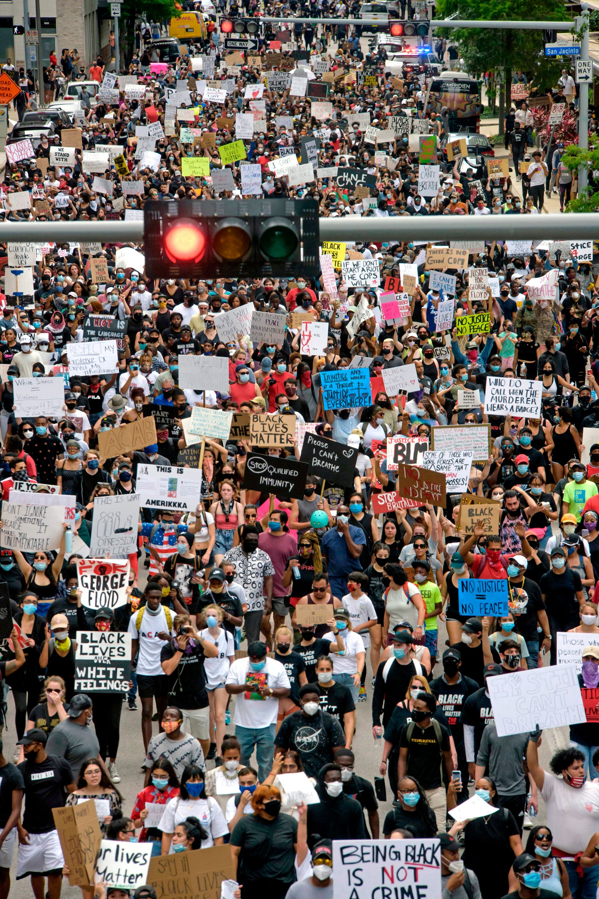
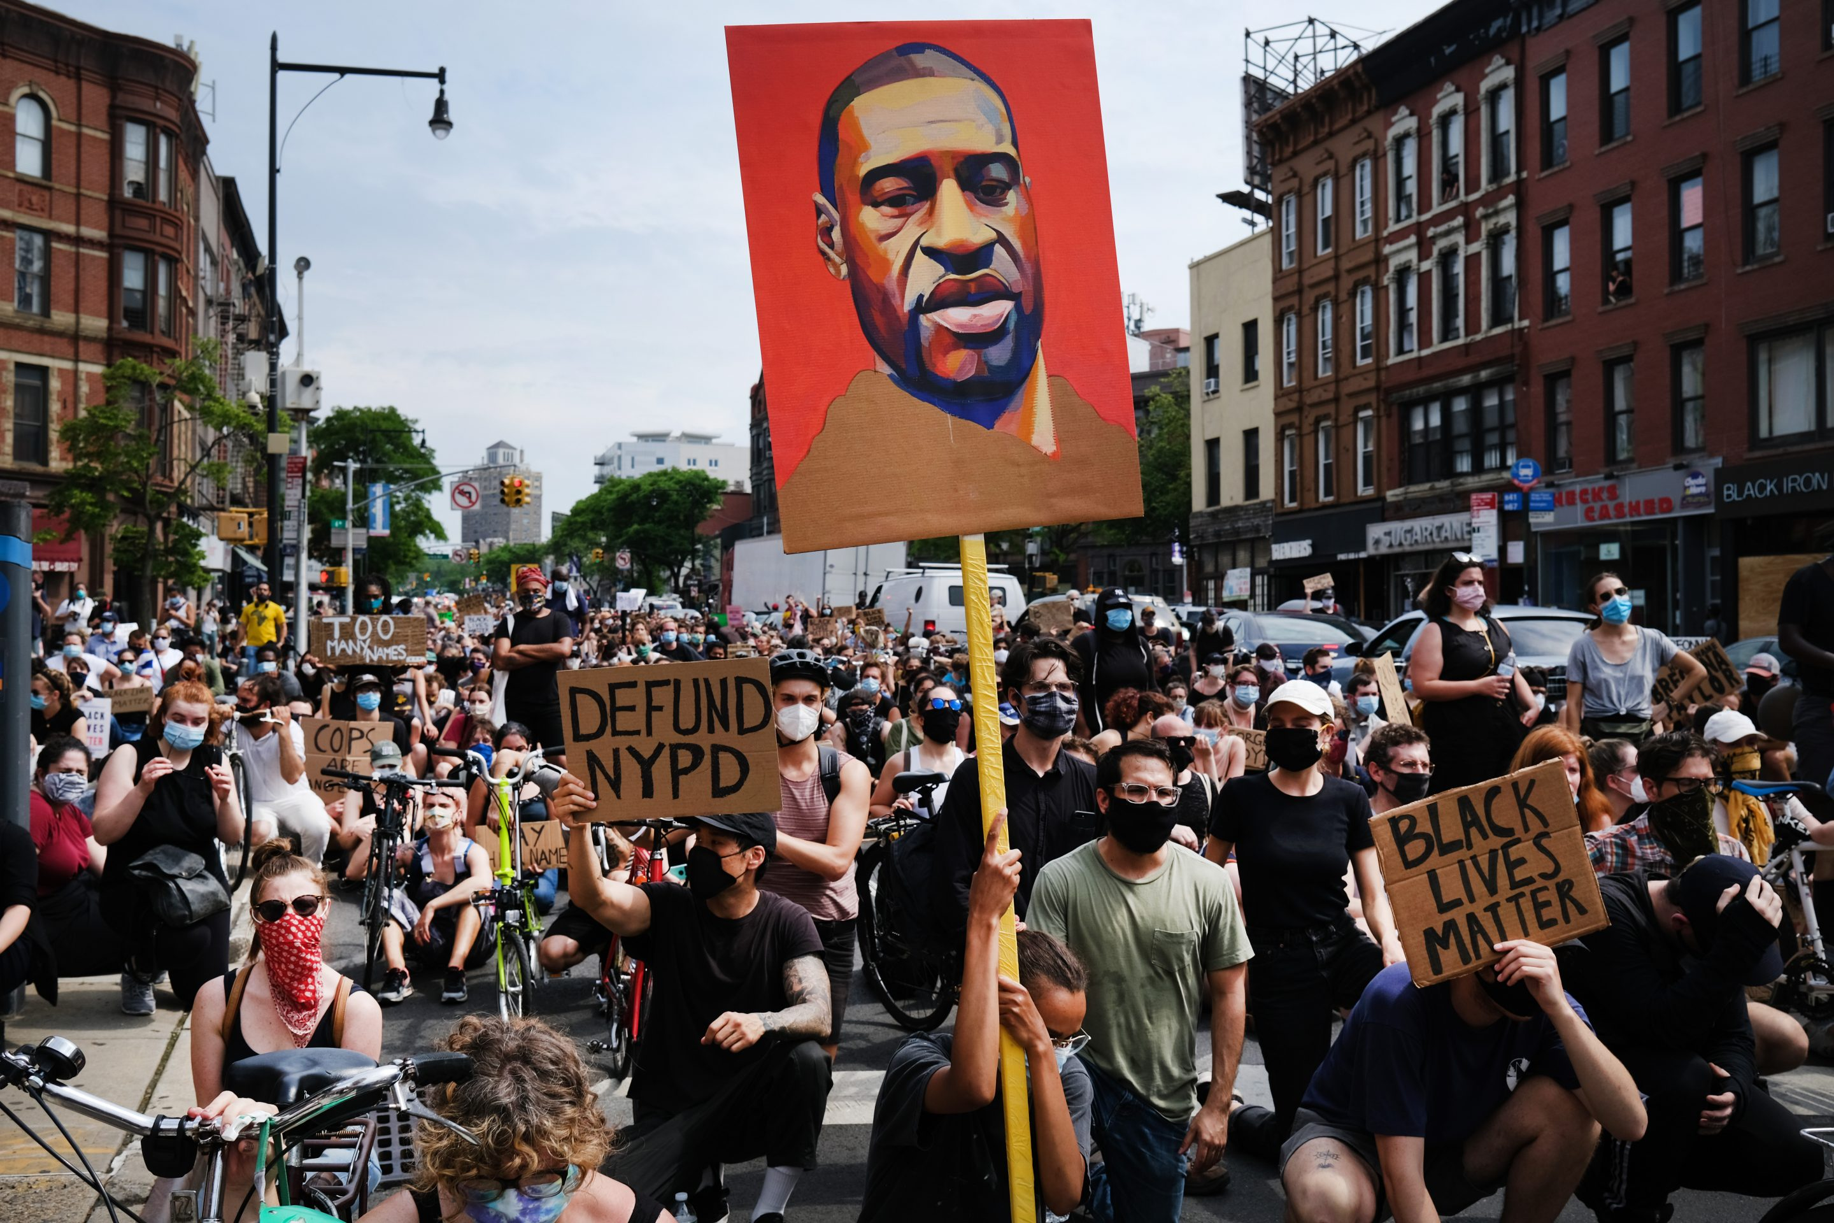
Methods
Case study of Justice For George Floyd
5 data-sets
geo-located Twitter data from Twitter API
geo-located protest data from ACLED
data on legislatives responses to policing from NCSL
data on 2016/2020 county/precinct level election results
2020 census demographic data
Data Science approach
Web scraping
Geospatial data analysis
Network Analysis
ML (classification, regression, clustering)
Notes:
How am I doing this?
I am using the social media movement #JusticeForGeorgeFloyd of last summer as a case study to drive this research
the social significance of the #JusticeForGeorgeFloyd social movement, the intenseuse of social media during the movement, its geographic coverage in terms of physical protest, and the still-ongoing political activity related to the movement make this case highly relevant for the study of the political implications of hashtag activism.

Slide 12
Methods and Experimental design
Data Sources
US Census Bureau
ACLED
Twitter API v2
NCSL
Web scraping
Data Collection
2016 county shapes and demographics
Geo-located social media posts and geo-located physical protests
State level legislative responses to policing
Notes:
Ok so lets look at the methods in which I use and the experimental design for this research
I use 4 primary data-sets
2016 census demographic data
1M geo-located tweets data from Twitter API
geo-located protest data from ACLED (the Armed Conflict Location & Event Data Project)
data on legislatives responses to policing from NCSL (National Council for State Legislatures)→ currently trying to find a more granular dataset

Slide 13
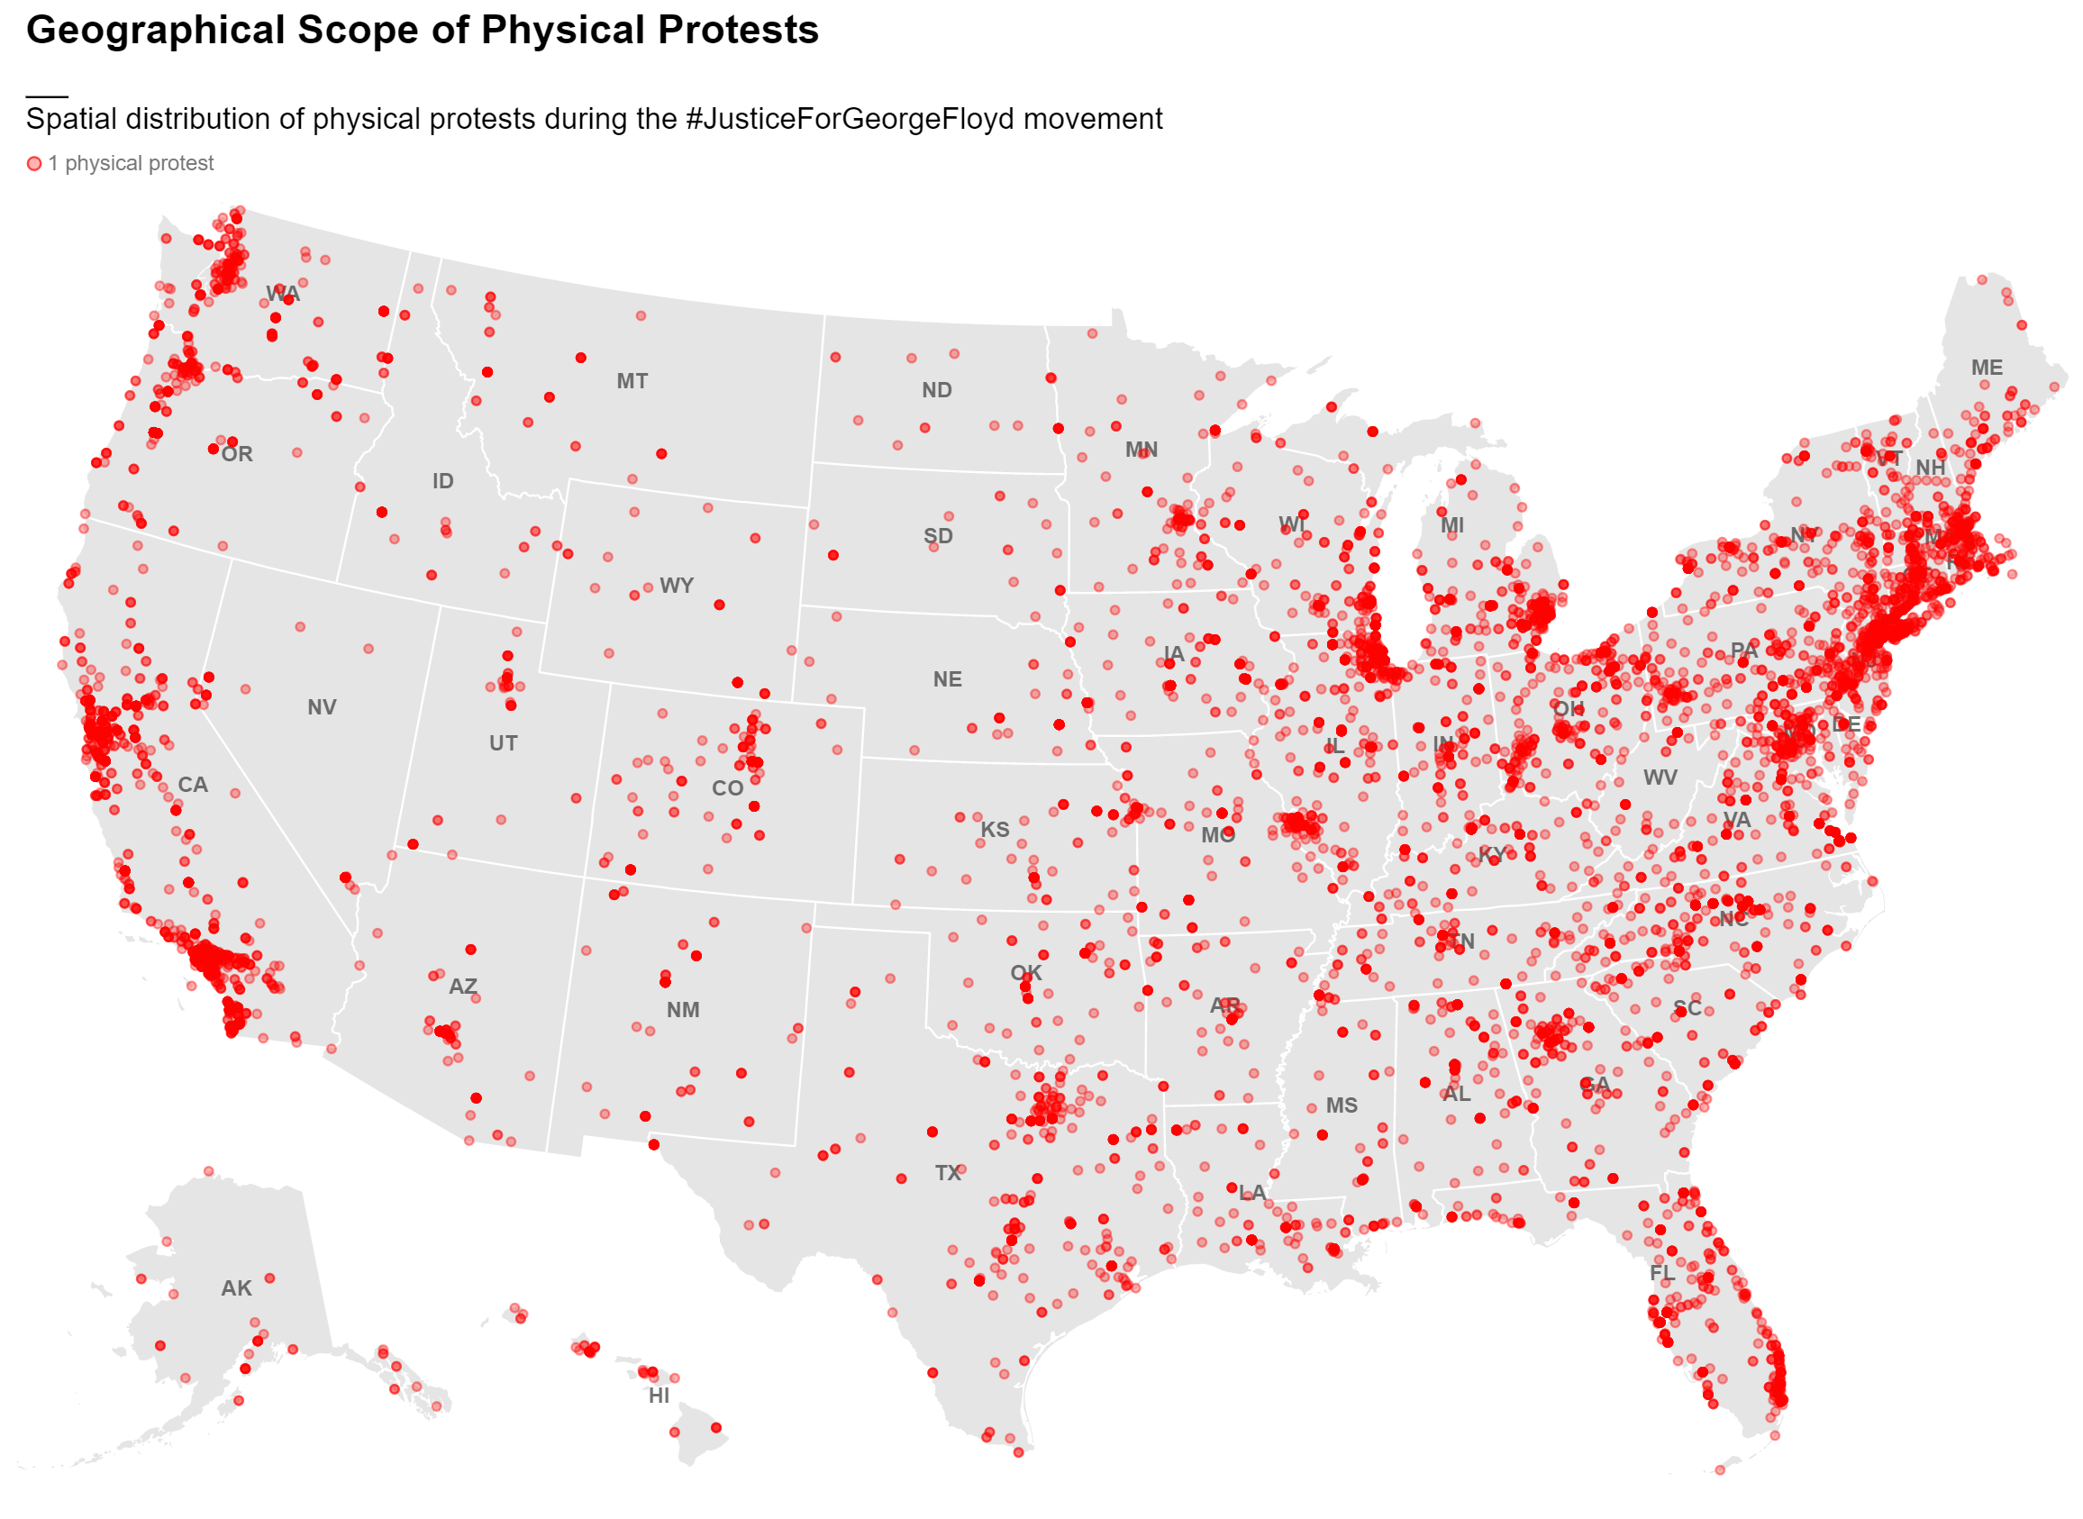
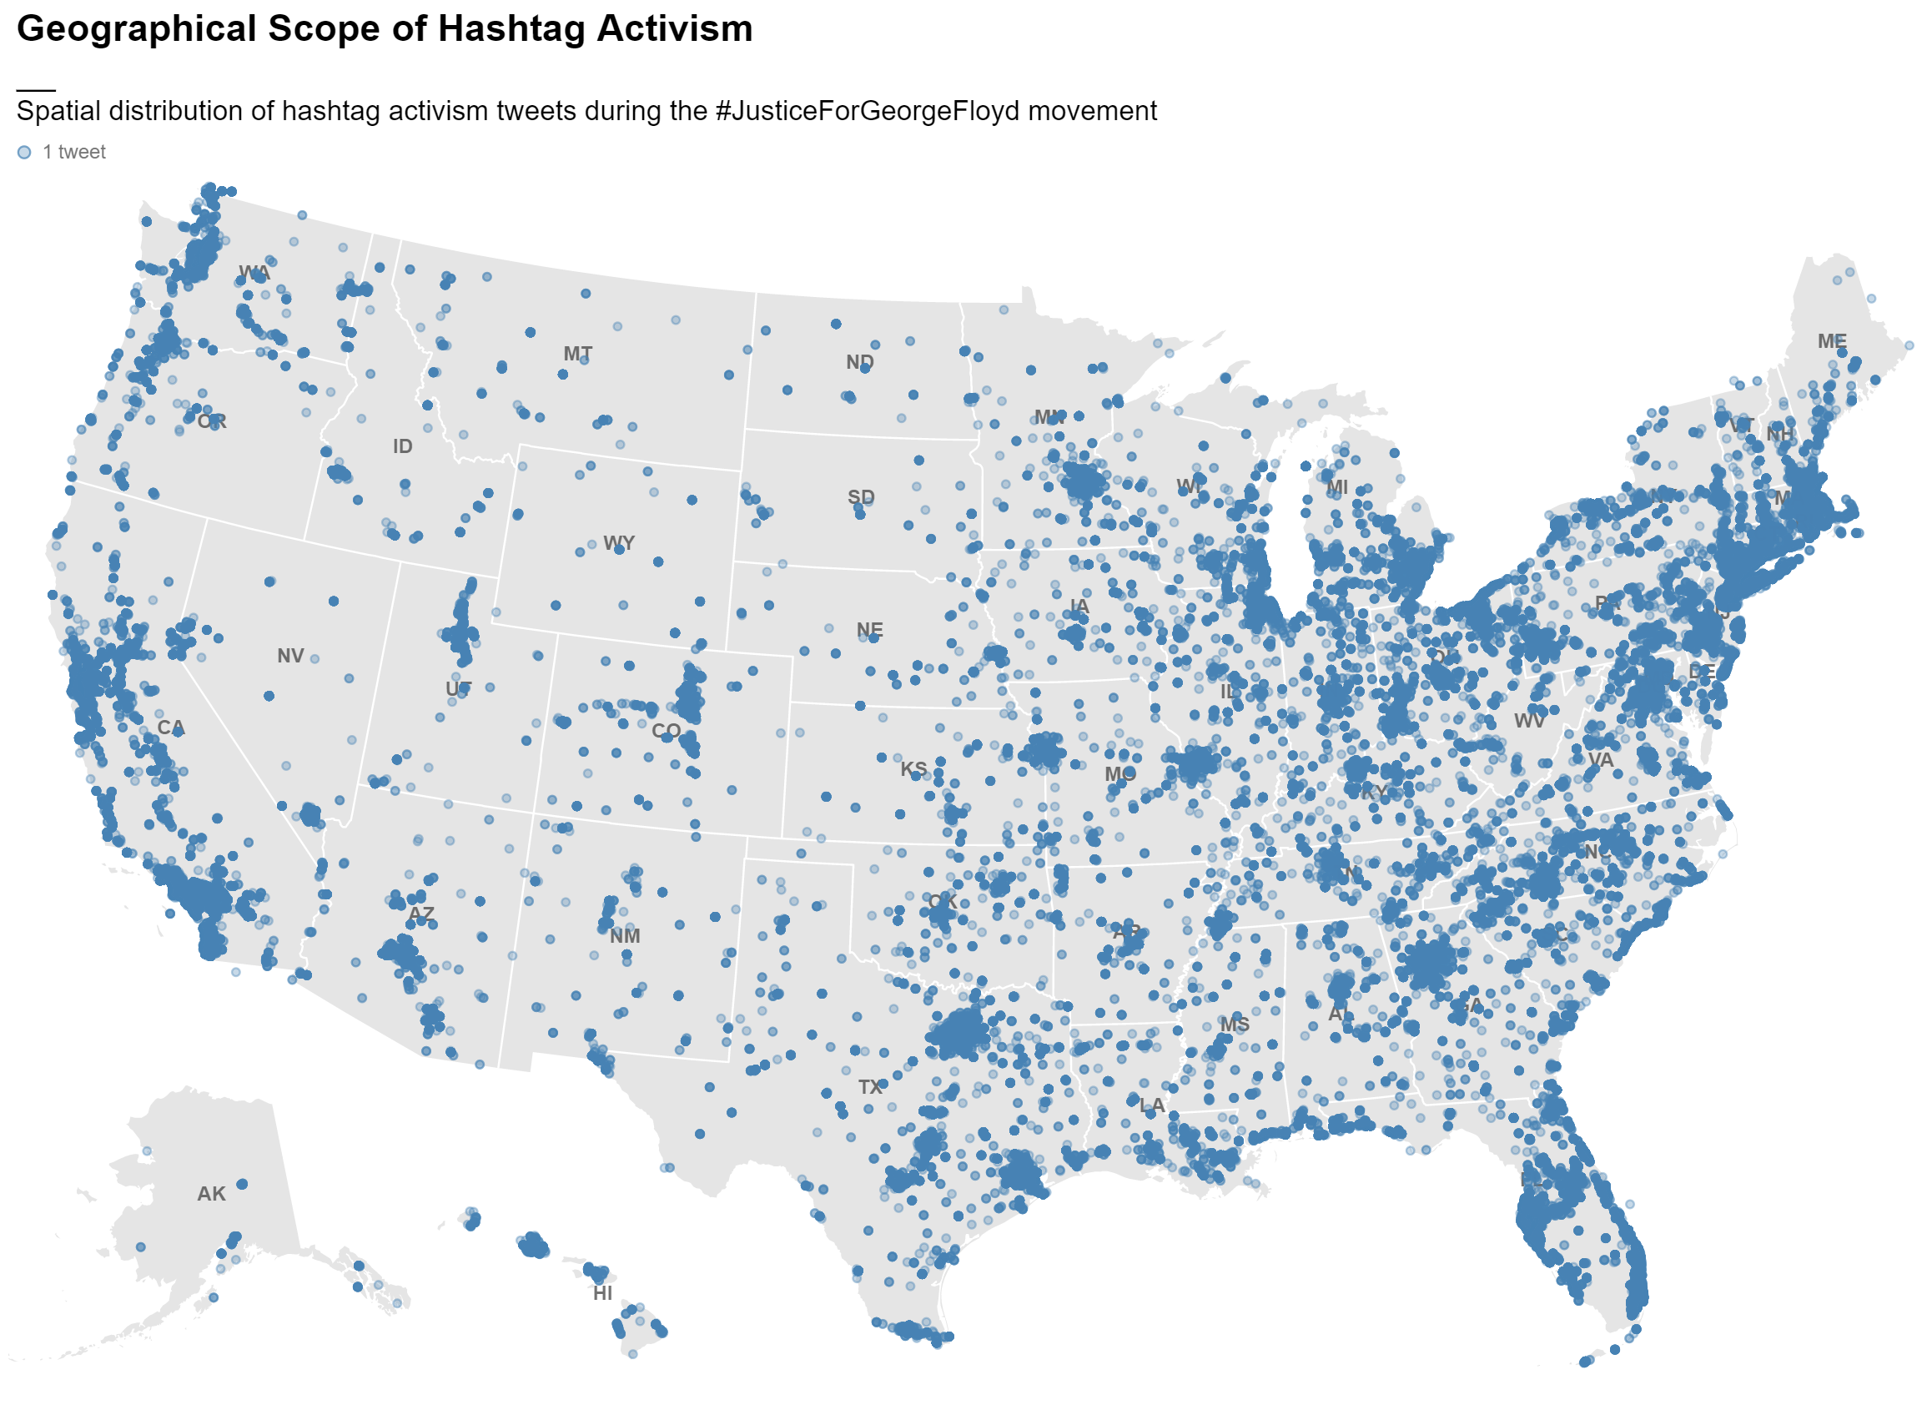
Methods and Experimental design
Data Sources
US Census Bureau
ACLED
Twitter API v2
NCSL
Web scraping
Data Collection
2016 county shapes and demographics
Geo-located social media posts and geo-located physical protests
State level legislative responses to policing
• 1 physical protest
• 1 tweet
Notes:
Ok so lets look at the methods in which I use and the experimental design for this research
I use 5 primary data-sets
1M geo-located tweets data from Twitter API
geo-located protest data from ACLED (the Armed Conflict Location & Event Data Project)
data on legislatives responses to policing from NCSL (National Council for State Legislatures)→ currently trying to find a more granular dataset
2020 census demographic data

Slide 14
Methods and Experimental design
Data Sources
US Census Bureau
ACLED
Twitter API v2
NCSL
Web scraping
Data Collection
2016 county shapes and demographics
Geo-located social media posts and geo-located physical protests
State level legislative responses to policing
Data Preprocessing
Data aggregated by county (raw count, population normalized count, network weighted count)
Data aggregated by day (count)
Geo-located social network
Data aggregated by state (number of legislative responses)
Notes:
The second step of my experimental design consists of pre-processing the data
Mainly I use the county and state geographies to aggregate counts of physical protests, tweets and legislative responses in total.
I also aggregate this data by day at the national, state, and county scale.
Finally, I use tweets to create a geo-located social network

Slide 15
Methods and Experimental design
Data Sources
US Census Bureau
ACLED
Twitter API v2
NCSL
Web scraping
Data Collection
2016 county shapes and demographics
Geo-located social media posts and geo-located physical protests
State level legislative responses to policing
Data Preprocessing
Data aggregated by county (raw count, population normalized count, network weighted count)
Data aggregated by day (count)
Geo-located social network
Data aggregated by state (number of legislative responses)
Time series modelling
Correlated time series analysis
Granger causality + cointegration
Multivariate time-series forecasting (VAR, LSTM)
Notes:
Third, let me introduce the first modelling technique: time series modelling
This method is used to perform correlated time series analysis, which I use to understand the correlation between tweet and protest time series at different time lags
I also use granger causality analysis, which is used to infer potential causal relationships between time series
Finally, in this part of the analysis I select and build a forecasting model to test whether one time series can be used to predict the other

Slide 16
Methods and Experimental design
Data Sources
US Census Bureau
ACLED
Twitter API v2
NCSL
Web scraping
Data Collection
2016 county shapes and demographics
Geo-located social media posts and geo-located physical protests
State level legislative responses to policing
Data Preprocessing
Data aggregated by county (raw count, population normalized count, network weighted count)
Data aggregated by day (count)
Geo-located social network
Data aggregated by state (number of legislative responses)
Time series modelling
Correlated time series analysis
Granger causality + cointegration
Multivariate time-series forecasting (VAR, LSTM)
Regression Analysis
tweets vs. physical protests
tweets vs. legislation count
Physical protest vs. legislation count
Notes:
The second modelling technique is regression analysis: this technique is used to model linear and power relationships between variables
I use regression analysis when looking at total counts of tweets, protests and legislation
And I use regression in combination with time series modelling, to understand linear relationships between variables as they change over time and at different time lags

Slide 17
Methods and Experimental design
Data Sources
US Census Bureau
ACLED
Twitter API v2
NCSL
Web scraping
Data Collection
2016 county shapes and demographics
Geo-located social media posts and geo-located physical protests
State level legislative responses to policing
Data Preprocessing
Data aggregated by county (raw count, population normalized count, network weighted count)
Data aggregated by day (count)
Geo-located social network
Data aggregated by state (number of legislative responses)
Time series modelling
Correlated time series analysis
Granger causality + cointegration
Multivariate time-series forecasting (VAR, LSTM)
Regression Analysis
tweets vs. physical protests
tweets vs. legislation count
Physical protest vs. legislation count
Network Modelling
Centrality metrics
Community detection
Network spatial interactions
Notes:
Finally, I use network modelling to calculate centrality metrics, extract communities, and explore how these metrics relate to space

Slide 18
Some Results
SQ. Who are the key actors involved in location-based hashtag activism for driving political processes?
Political processes
Legislative responses
Social Movements
Physical protest
SQ. What is the relationship between location-based hashtag activism and physical protest activity?
Hashtag Activism
SQ. What is the relationship between location-based hashtag activism and legislative action?
Key Actors
Notes:
Ok, so let’s dive into some results that I have obtained so far

Slide 19
Political processes
How can location-based hashtag activism influence place-specific political processes in the United States?
SQ. What is the relationship between location-based hashtag activism and physical protest activity?
Physical protest
Hashtag Activism
Notes:
Let’s focus on the second subquestion: What is the relationship between location-based hashtag activism and physical protest activity?

Slide 20
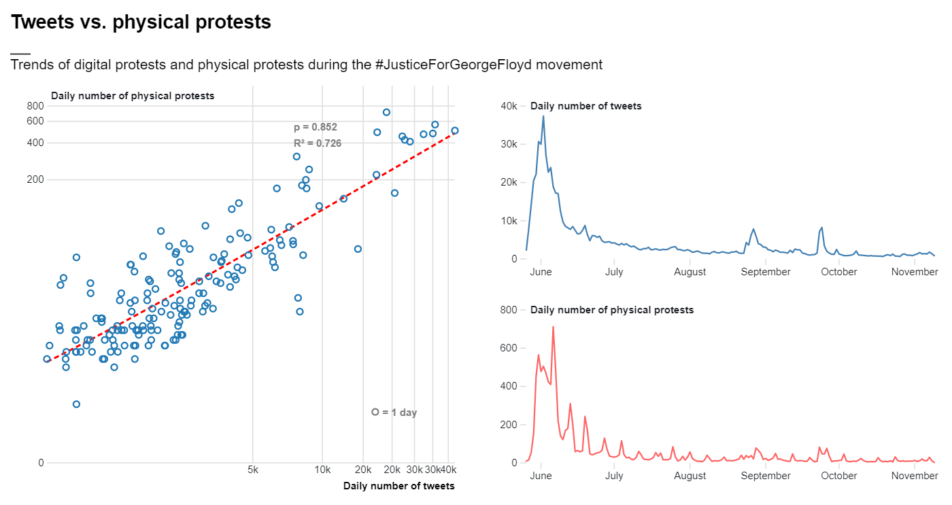
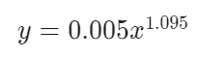
Notes:
In this slide you can see two charts:
On your left you have a scatterplot illustrating the relationship between daily number of physical protests and daily number of tweets at the national scale
I found that these two variables are related by a power law and can be modelled with a power law regression
As we can see physical and digital protests are very closely related. On days where people protest more on social media, people also protest more in the street, and vice versa. In the case of #JusticeForGeorgeFloyd, people used Twitter to express outrage about events of police brutality and to organize physical protests. During protests, more acts of police brutality were documented and shared on Twitter, which led to yet more protests and to more people showing up to protests, and so on.

Slide 21
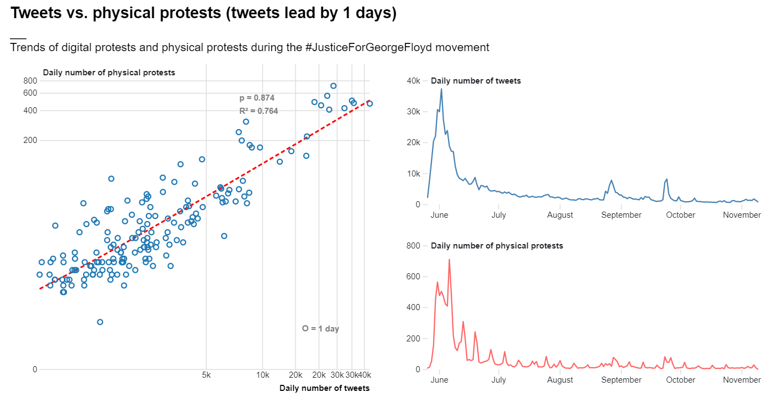
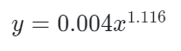
Notes:
Interestingly, I found that this relationship is even stronger when we use a time lag of 1 day for the tweet data. Meaning that tweets happen one day before protests

Slide 22
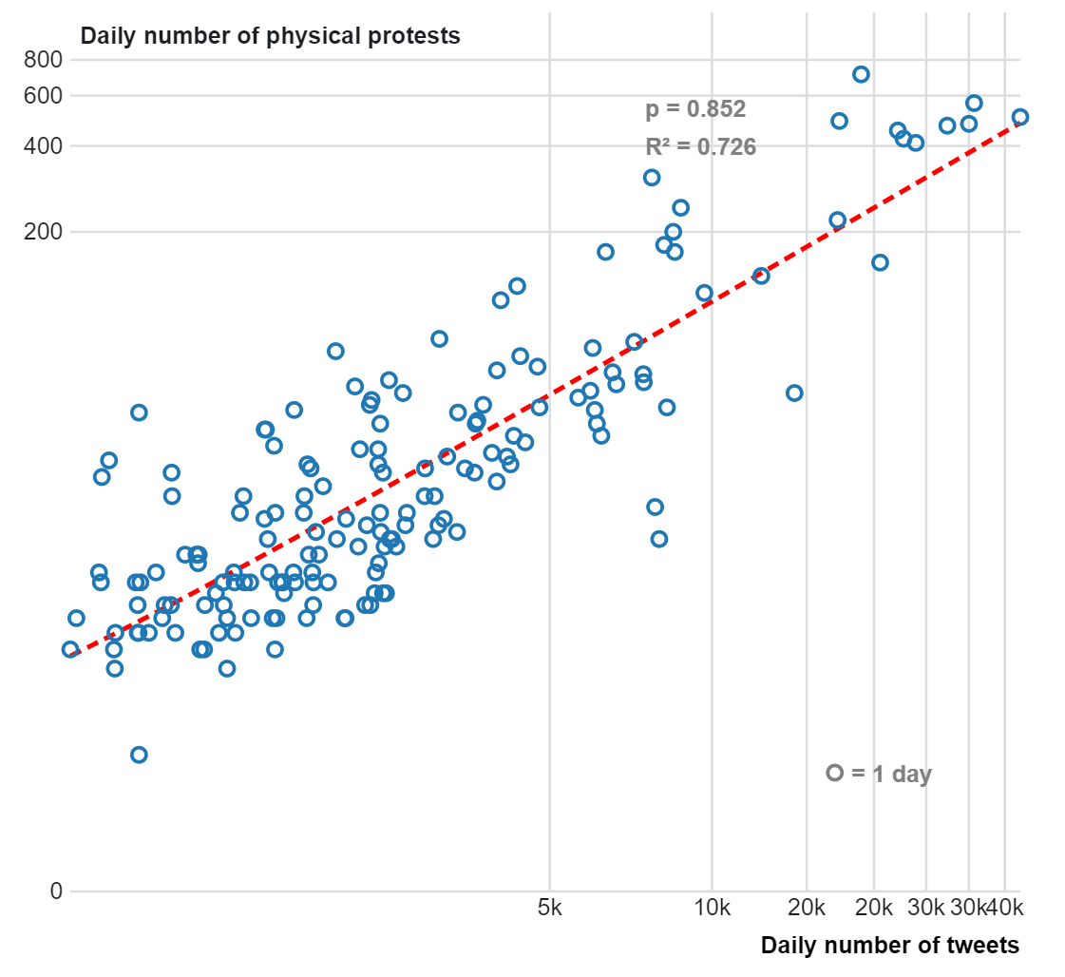
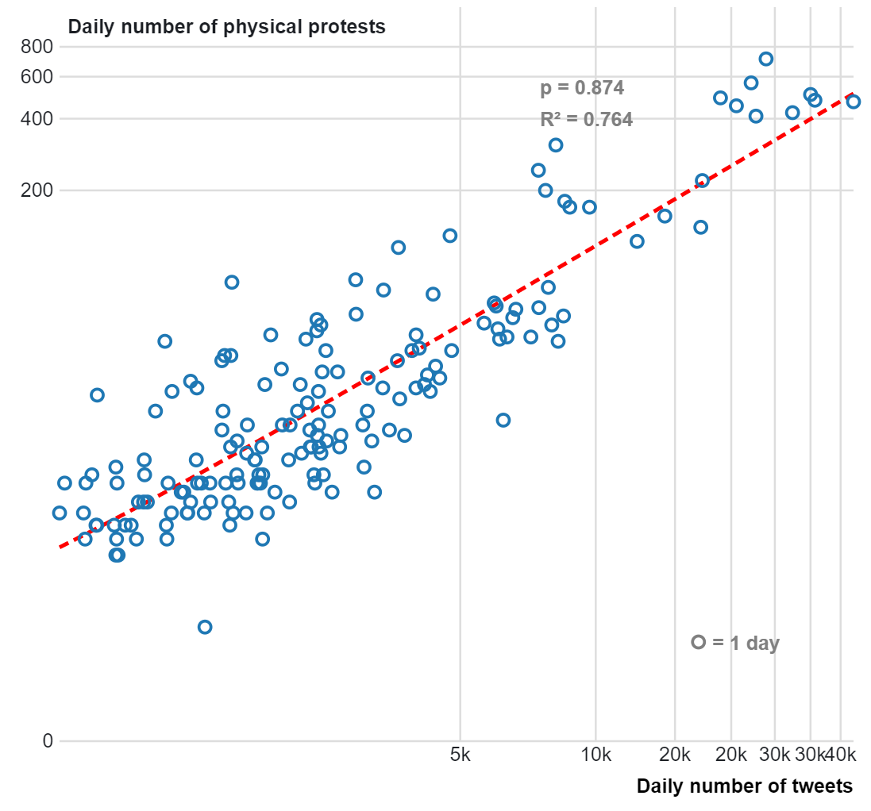

Slide 23
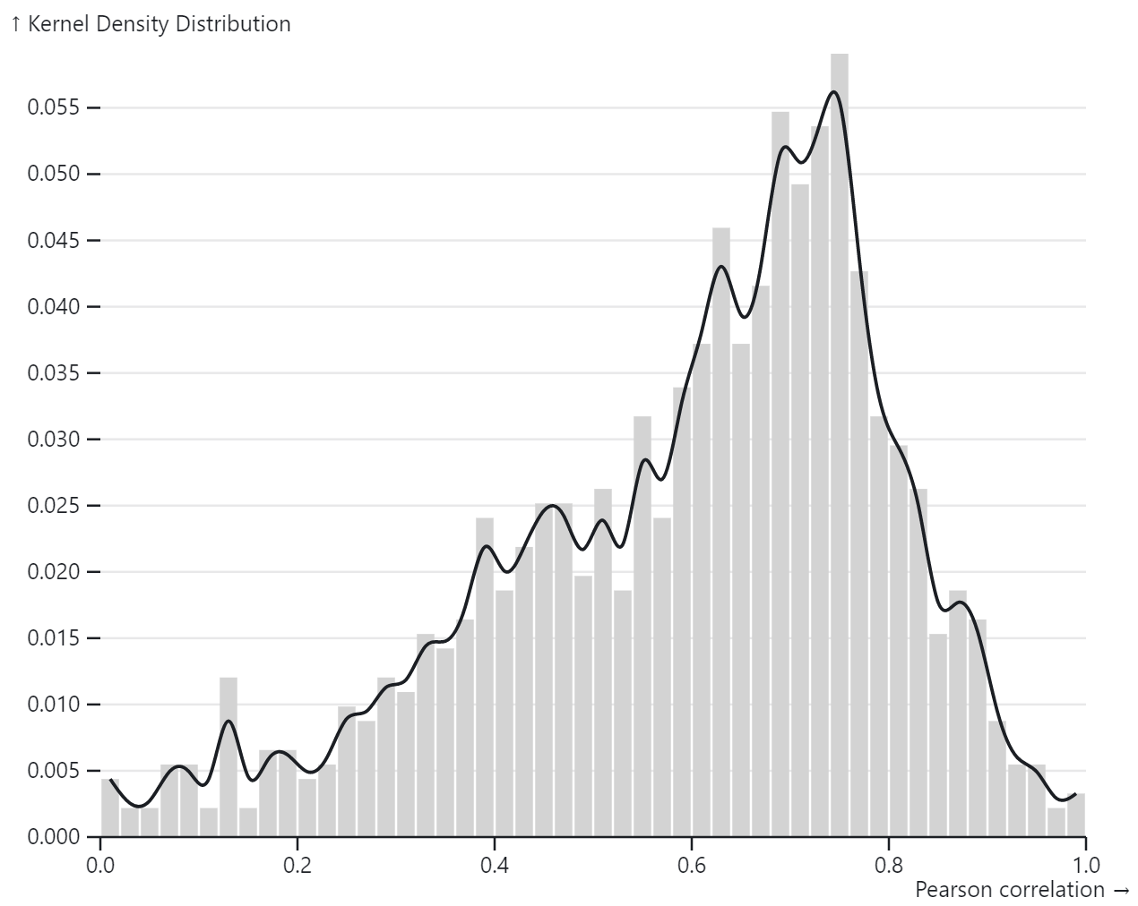
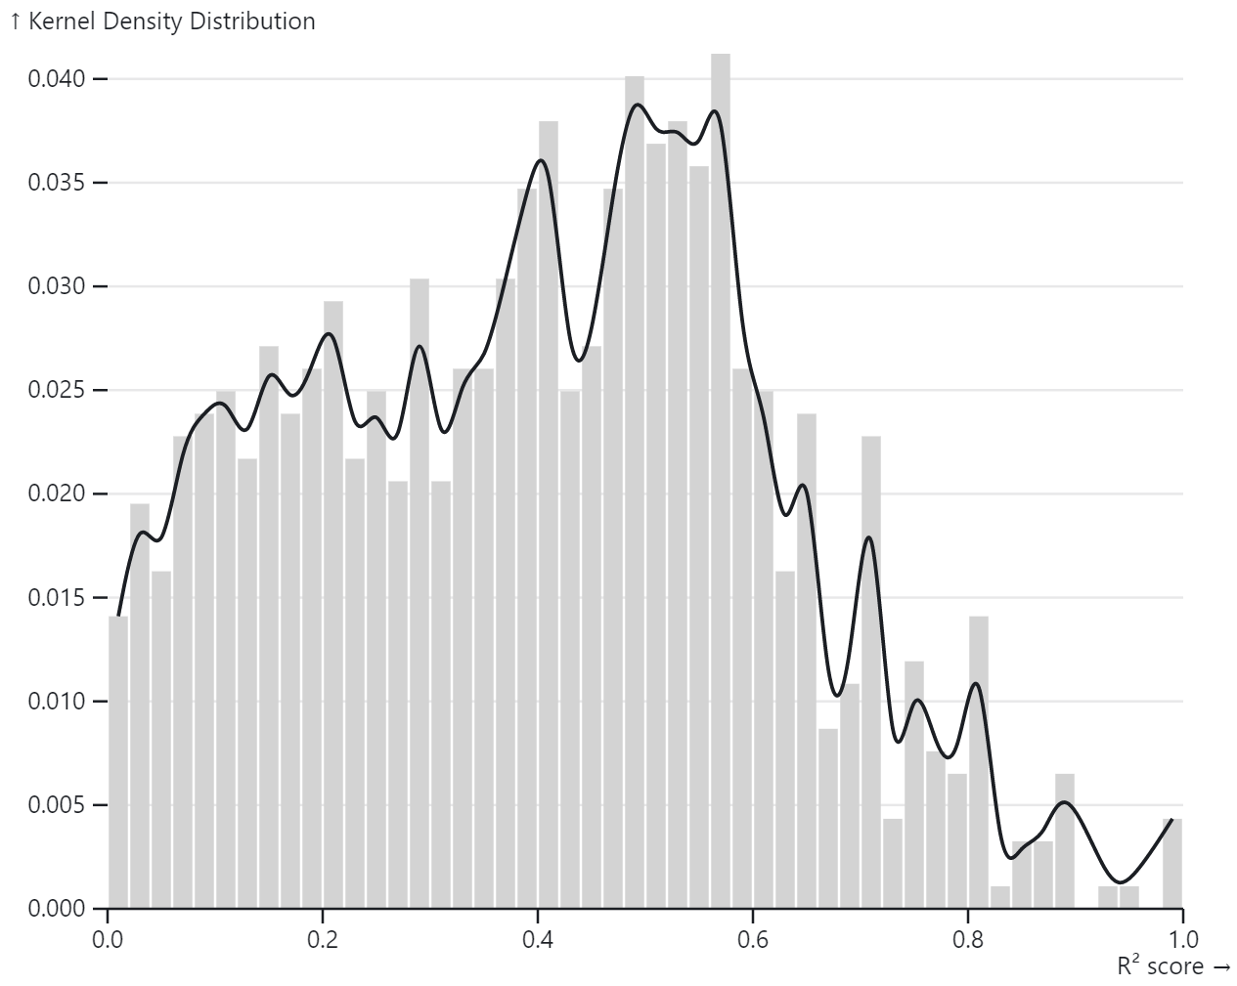

Slide 24
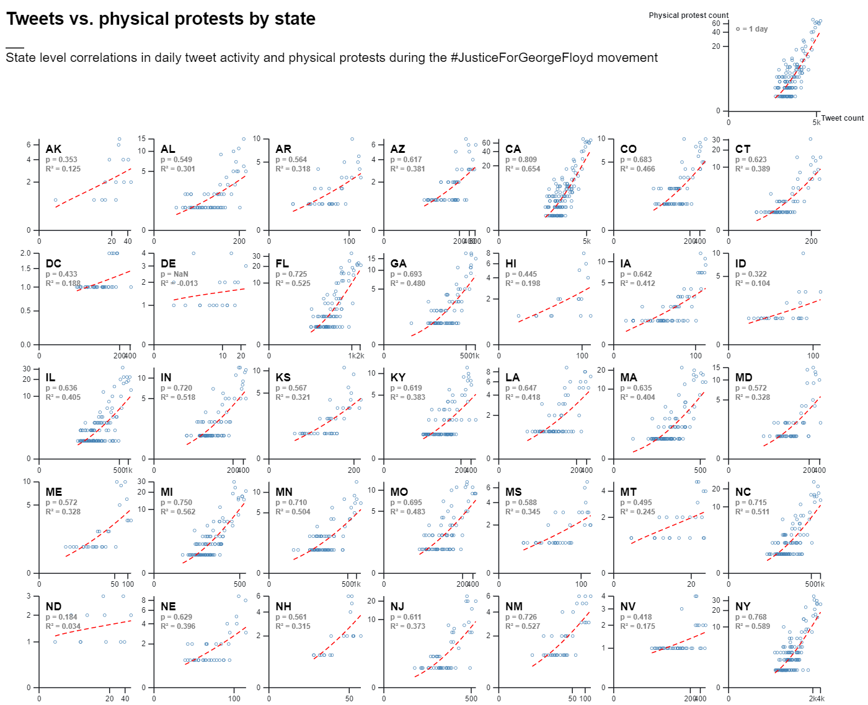
Notes:
Strikingly, this relationship holds at smaller spatial scales as well. Here you can see it for each of the US 51 states, each having a positive correlation between tweet volume and protest activity

Slide 25
Cross Correlation and Granger Causality
In 41 out of 51 states a better correlation is obtained when tweets lead by 1 or more days
In all states, the highest correlations are obtained when levels of tweeting and protesting are above average (peak anomalies), but on "regular" days we obtain lower correlations.
For 32 states out of 51 we can reject the null-hypothesis that tweet count does not cause protest count
Notes:
I also performed time lagged cross correlation analysis and granger causality analysis and found that

Slide 26
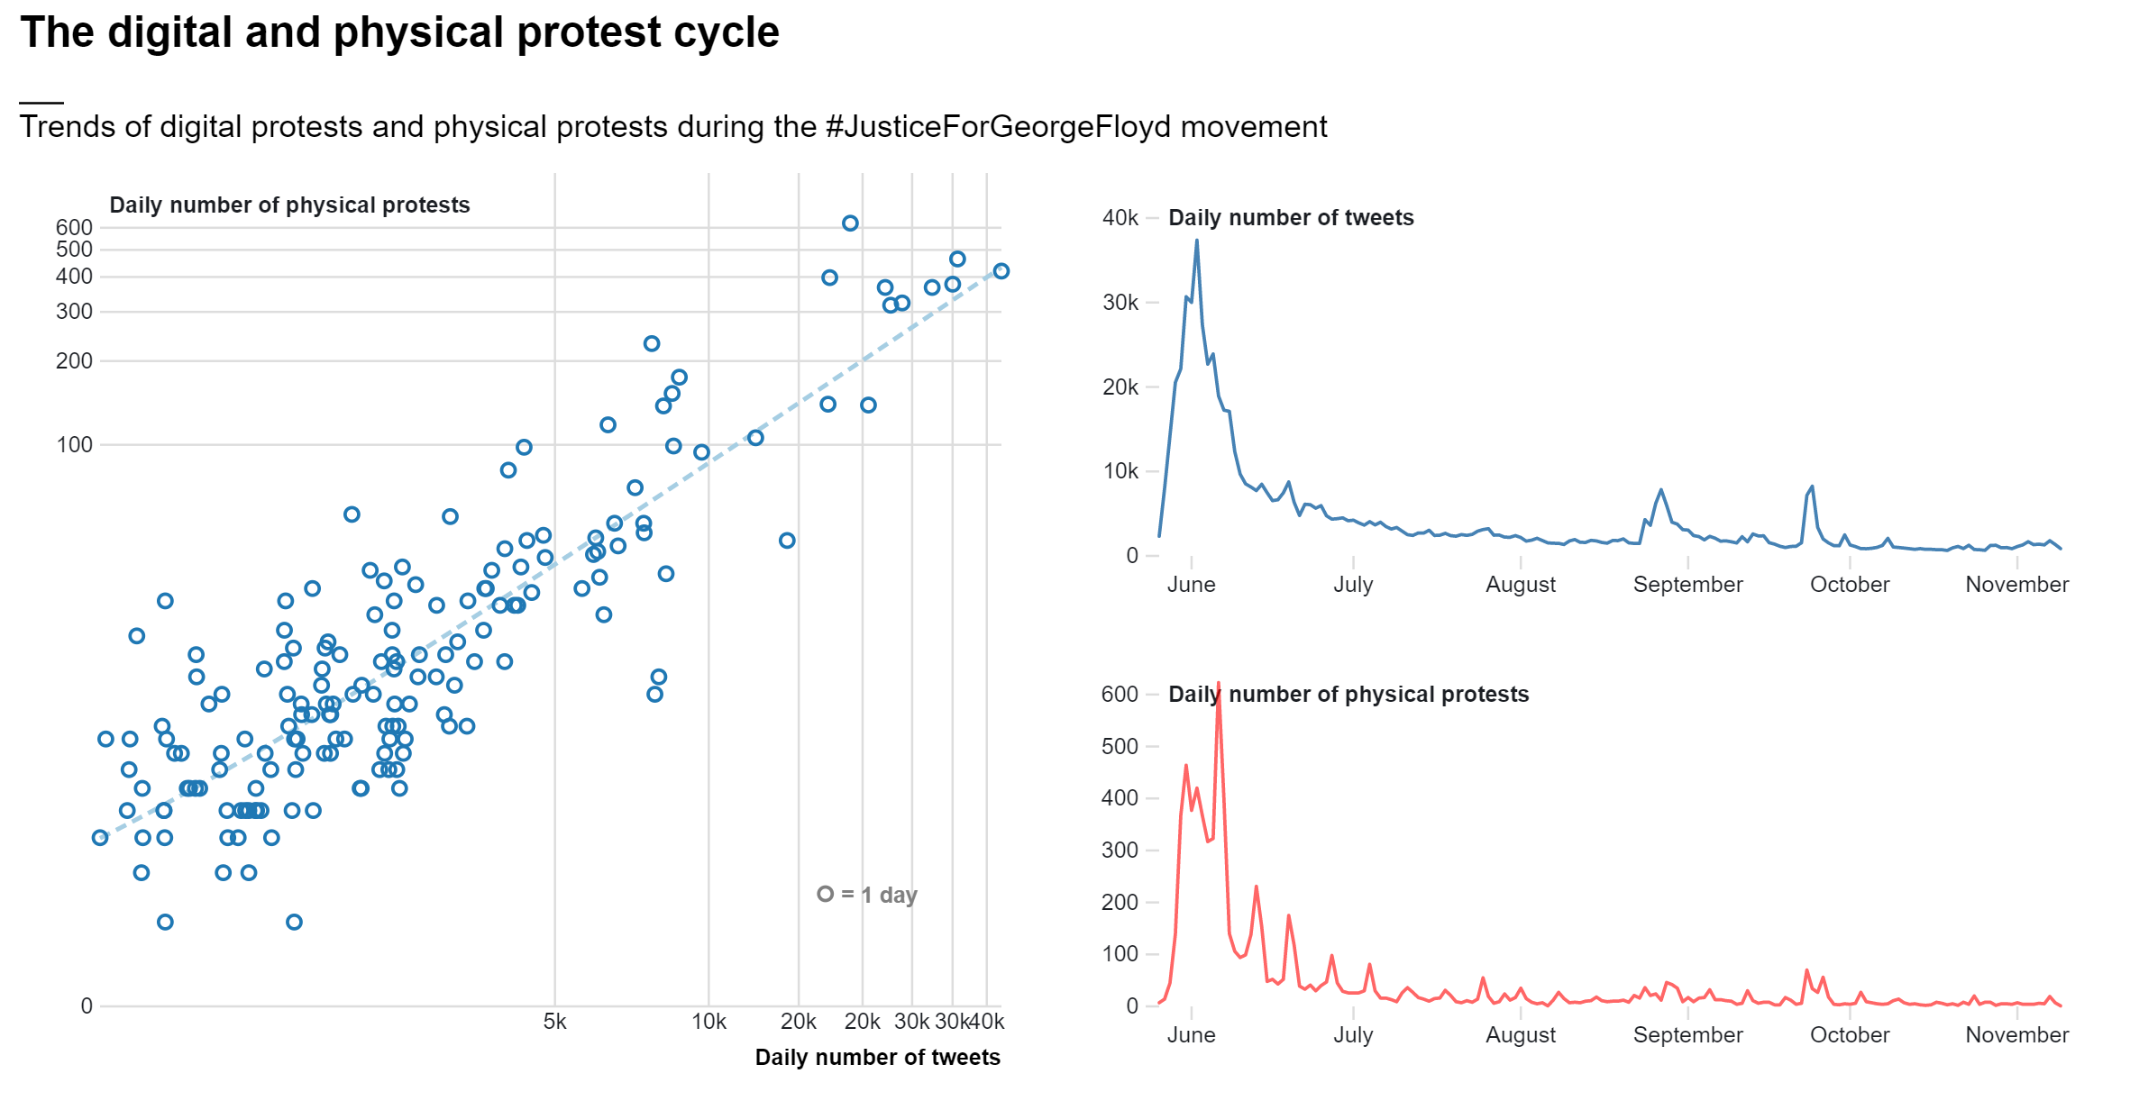
++
Digital Protest
Physical Protest
+
Notes:
This trend illustrates an intuitive cycle, where digital protest and physical protest interact together and amplify one-another. But it seems that tweet activity may be causing physical protest, and not the other way around.

Slide 27
Next steps
Build predictive model to forecast the number AND location of physical protests based on tweet volume
VAR (Vector Autoregressive Model)
LSTM (Long Short Term Memory neural network)
Filter tweet data based on language used (e.g. only tweets that mention the word “protest”, filter out counter movement tweets etc.) and see if accuracy improves

Slide 28
Political processes
How can location-based hashtag activism influence place-specific political processes in the United States?
SQ. What is the relationship between location-based hashtag activism and physical protest activity?
Legislative responses
Social Movements
Physical protest
Hashtag Activism
SQ. What is the relationship between location-based hashtag activism and legislative action?
Notes:
Let’s now focus on the third subquestion: what is the relationship between hashtag activism and legislative action

Slide 29
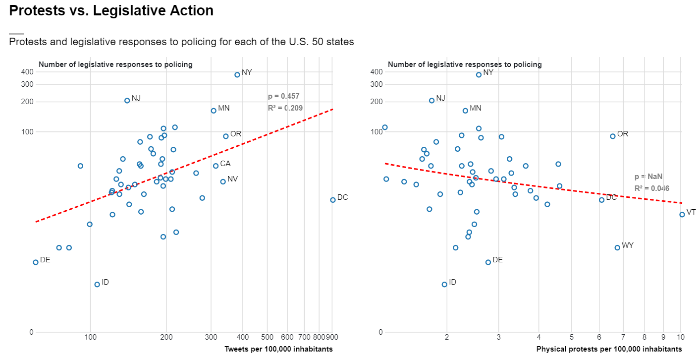
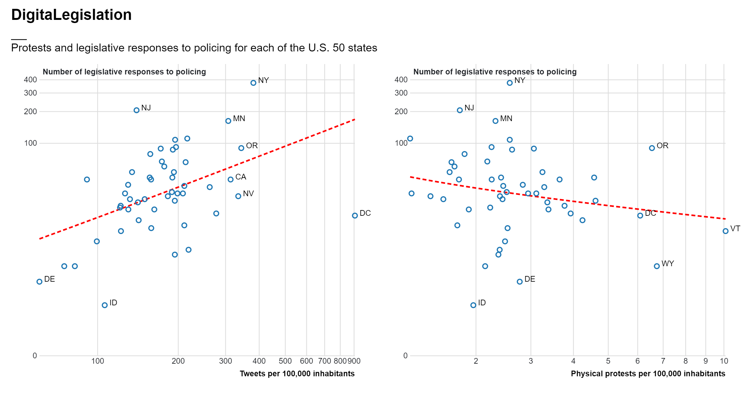
Notes:
So far, I have only looked at the relationship between total counts of legislative responses to police brutality and both tweet counts and physical protests counts
In this graph you can see…
Here the story is very much consistent with what we have previously observed: we observe a positive trend between the number of tweets per 100,000 inhabitants in a given place and the number of legislative responses to policing in that place

Slide 30
Notes:
on the other hand, absolute counts of physical protests bear no (or even opposite) relationship with subsequent state-level legislative change

Slide 31
digital protest in place x
=
more legislative responses in place x
physical protest in place x
=
less legislative responses in place x
Notes:
So, while more digital protest in one place is an indication of more legislative responses, more physical protests in one place is an indication of less legislative responses

Slide 32
Next steps
Currently only looked at total volume of both tweets and physical protests
Incorporate temporal dimension (correlated time series, granger causality etc)
Test regression model for prediction
Notes:
As an iterative process

Slide 33
Political processes
SQ. Who are the key actors involved in location-based hashtag activism for driving political processes?
How can location-based hashtag activism influence place-specific political processes in the United States?
SQ. What is the relationship between location-based hashtag activism and physical protest activity?
Legislative responses
Social Movements
Physical protest
Hashtag Activism
SQ. What is the relationship between location-based hashtag activism and legislative action?
Key Actors
Notes:
Let’s now focus on the las subquestion: Who are the key actors involved in location-based hashtag activism for driving political processes?
This section of my research is still very much in an exploratory phase, but I have made some initial steps in (I hope) the right direction

Slide 34
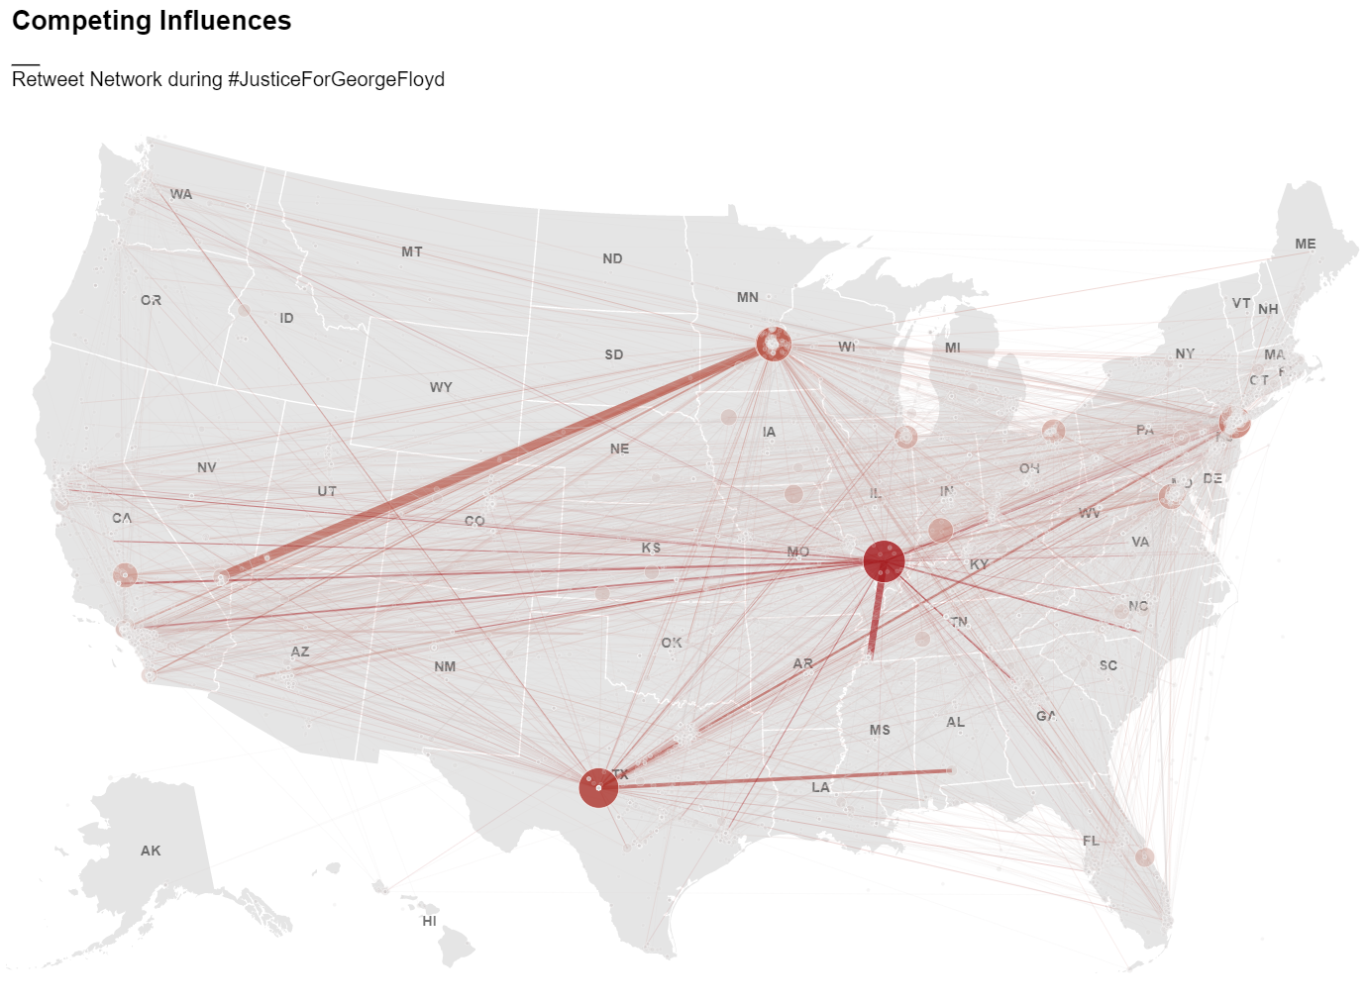
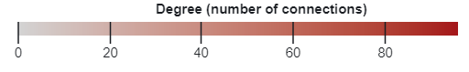
Notes:
In this slide you can see the social network from the #JusticeForGeorgeFloyd movement from May to November 2020, mapped in space. Where:
Each node/circle represents a user
Each link represents a connections between two users by means of retweet
The size and color of a node represents its degree, or the number of users it is connected to
The thickness of a link represents the strength of the connection between two users, or the number of times a user was retweeted by the same user
I have made an interactive visualization of this, which has proven very useful to get some initial insight into sources of influence during the case of #JusticeForGeorgeFloyd, in terms of:
who the most influential actors are
from what geographical locations are these actors excercing their influence
and finally, which geographical locations are these actors reaching through their social influence

Slide 35
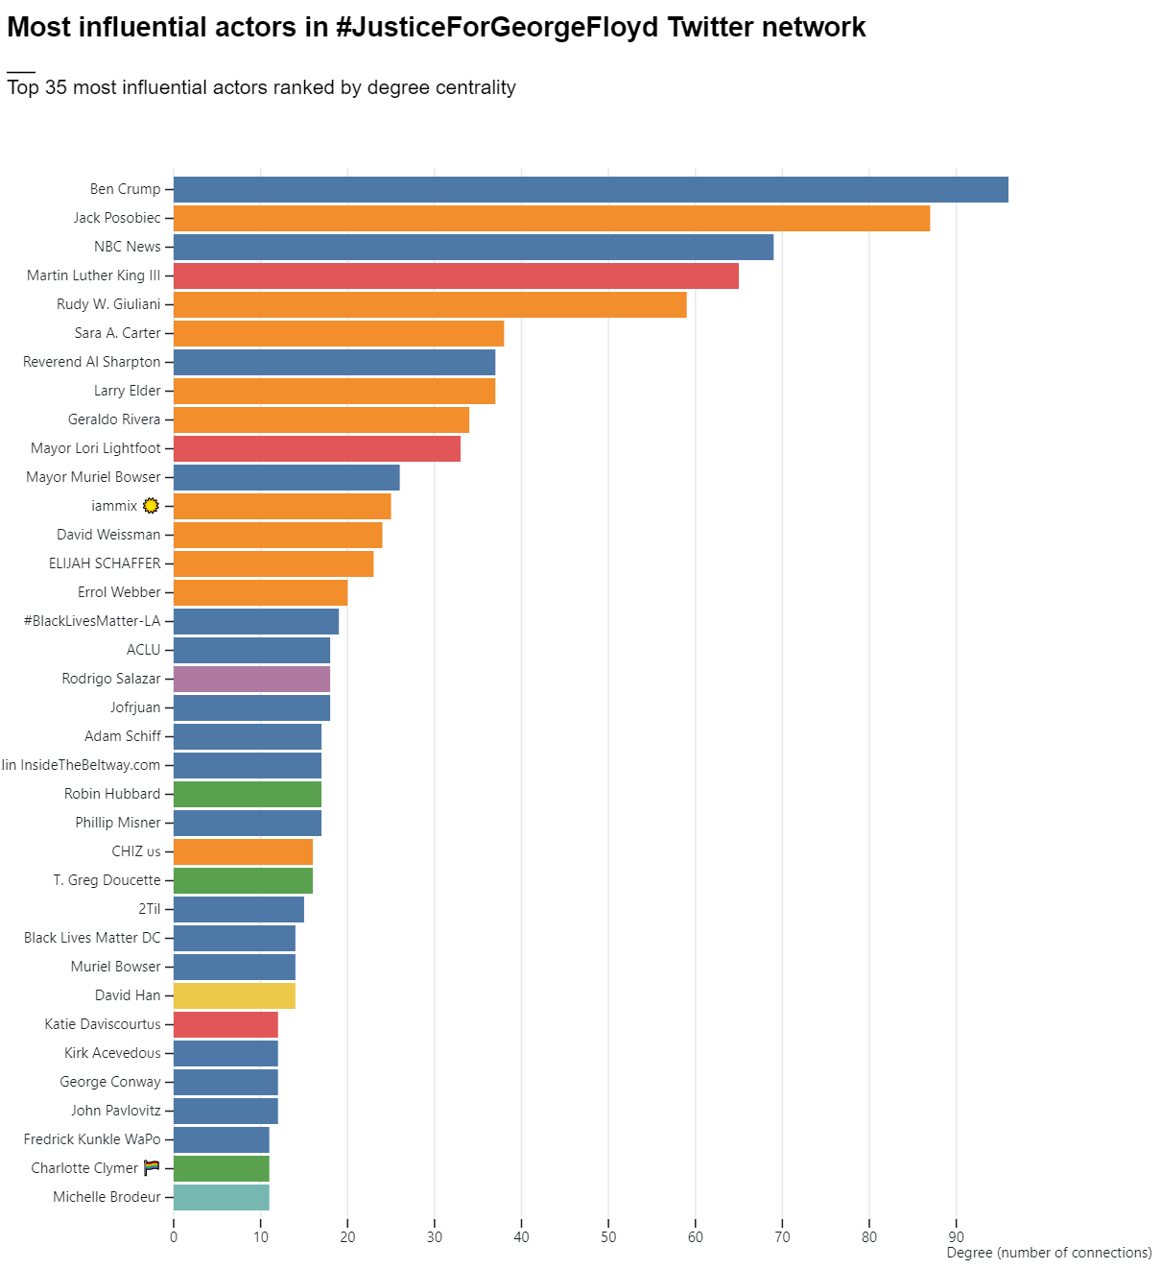
Community 1
Community 2
Community 3
Community 4
Community 5
Community 6
Community 7
Notes:
Through this network I was able to identify the most influential actors based on degree centrality during the #justiceforgeorge movement

Slide 36
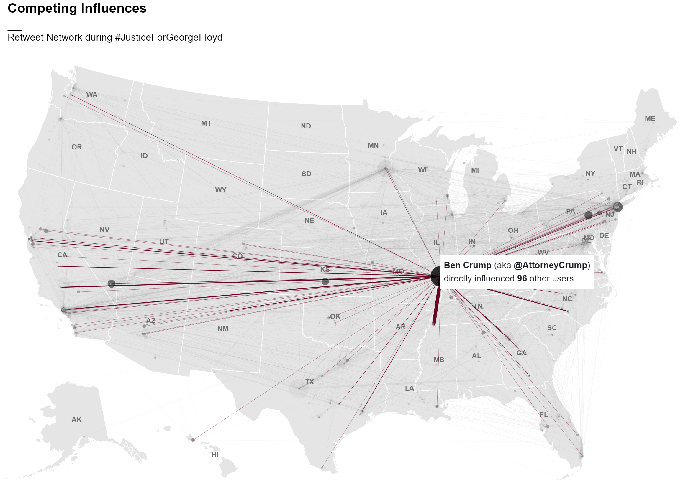

Slide 37
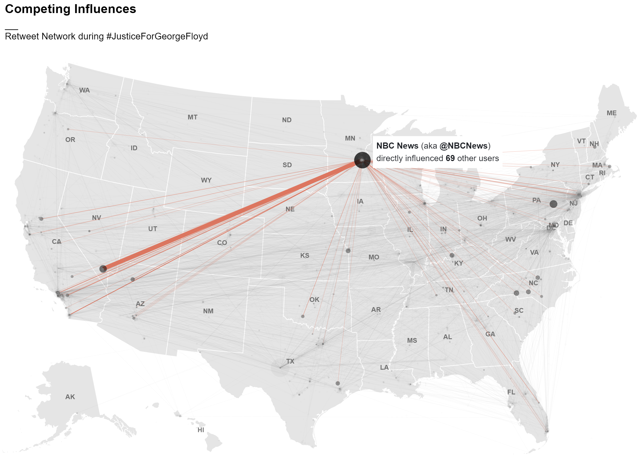

Slide 38
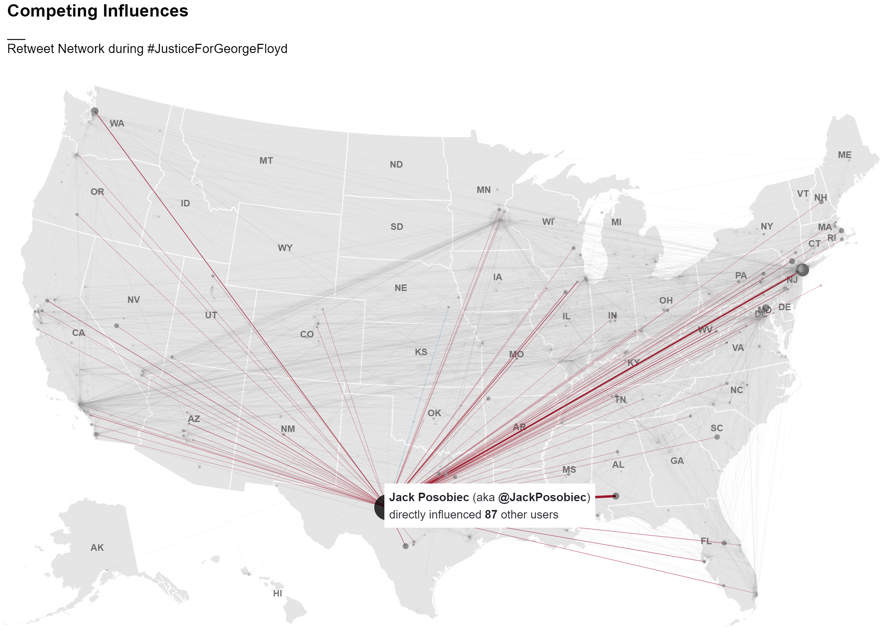

Slide 39
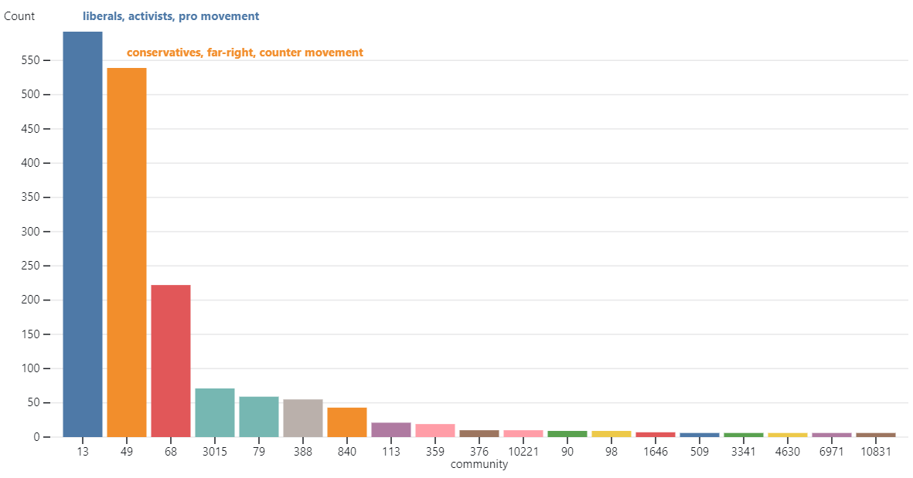

Slide 40
Next steps
Calculate more centrality metrics (betweenness, closeness, eigen)
Interpret key actors results
Interpret results of community detection
Relate network metrics with spatial relationships
Incorporate temporal element: model evolution of network over time (information diffusion over time)
Notes:
As an iterative process

Slide 41
where we are now…
SQ1: 50% of the way
SQ2: 80% of the way
SQ3: 60% of the way
Thesis report: 40% of the way
…where we are going…
Finish analysis (next 2 weeks)
Write methodology (next 2 weeks)
Write results, discussion and conclusion (second half of June)
Notes:
This is where I am at with this section of my thesis
Now I have some ideas of how to move forward:
Incorporate the temporal element in the network analysis
Leverage other net characteristics?
Repeat this analysis with the current socio political events happening as we speak

Slide 42
Questions
Feedback
Criticism
Fallacies
Advice
.
.
.
?

Slide 43

Methods
Case study of Justice For George Floyd
5 data-sets
1M geo-located tweets data from Twitter API
geo-located protest data from ACLED
data on legislatives responses to policing from NCSL
data on 2016/2020 county/precinct level election results
2020 census demographic data
Data Science approach
Web scraping
Geospatial data analysis
Network Analysis
ML (classification, regression, clustering)
Notes:
Finally I am using a Data Science approach for this research:

Slide 44
Methods
Case study of Justice For George Floyd
5 data-sets
1M geo-located tweets data from Twitter API
geo-located protest data from ACLED
data on legislatives responses to policing from NCSL
data on 2016/2020 county/precinct level election results
2020 census demographic data
Data Science approach
Web scraping
Geospatial data analysis
Network Analysis
ML (classification, regression, clustering)
iterative process
Notes:
As an iterative process

Slide 45
Trivik:
Logistical comment:
present each question in order
seek out social scientist to interpret results
Who the actors are in terms of characteristics: less about the personal name
Social science literature that suggests relationships through
Martijn:
Granger causality assumes that there is two variables at play: does it really make sense?
I want to challenge you a bit more in critically reflecting in what all does this mean
Focus on SQ2+3 finish analysis and discussion
Network:
Normalize network using entropy
Specific metrics that look at influence of people
Greenlight: readable from A-Z but not fully complete
Chap 4 (most stuff in appendix)

